Slide 1
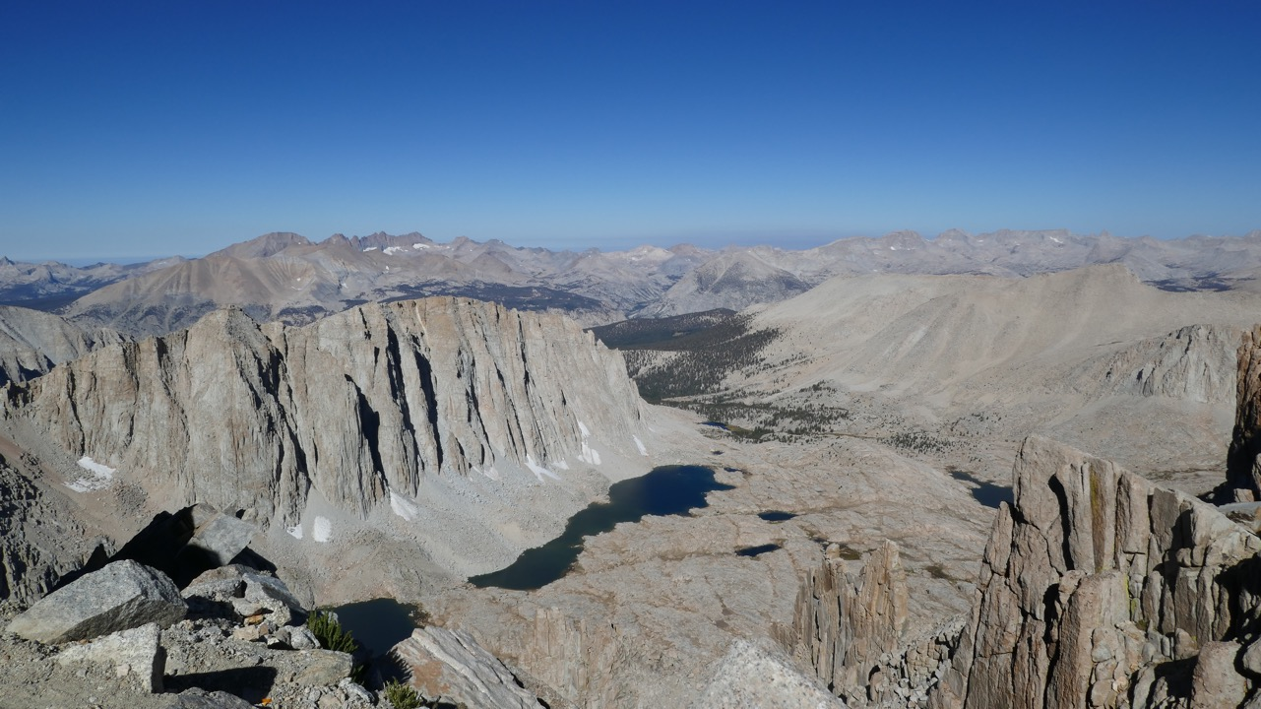
Thermal Evolution of the Sierra Nevada Batholith, California, & Implications for Strain Localization
Paper by Nadin et al (2016)
Presentation by Solomon Feinstein

Slide 2
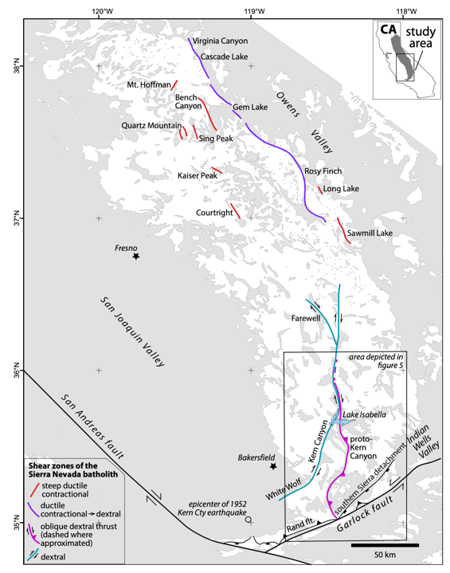
Introduction
The Sierra Nevada Batholith hosts multiple shear zones that illuminate the deformative past of the Magmatic Arc during the Cretaceous
This study seeks to understand this deformative past by analyzing the temperature and pressure of how magma cooled through U-Pb Zircon (900ºC), Ar Hornblende (525ºC), & Ar Biotite (325ºC) dates in different parts of the batholith
Dates from the north & central SNB were taken from literature, but the study took their own samples from the southern section of the SNB

Slide 3
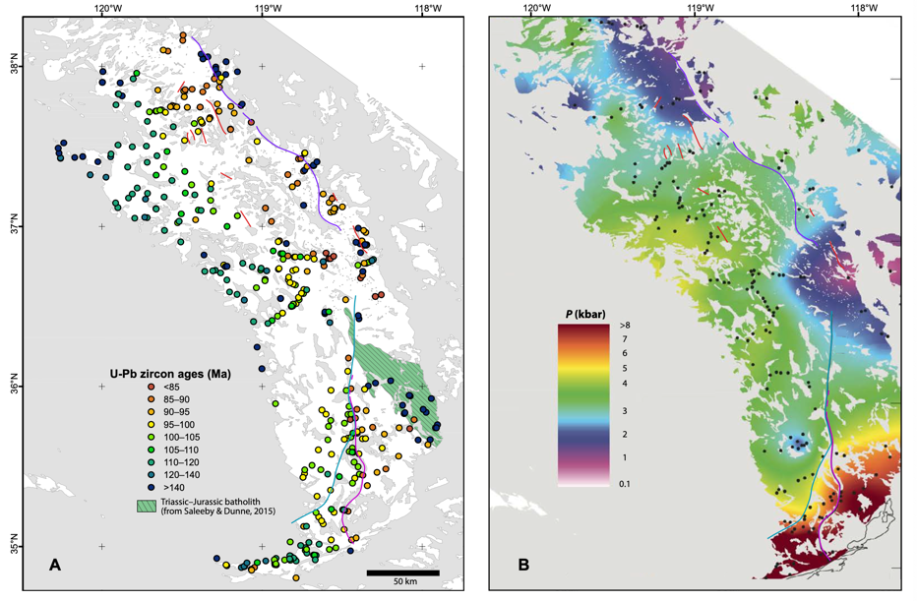
Regional U-Pb Zircon Ages & Pressure of SNB
Sierra Nevada contains plutonic rock as old as 250 MA, but lion’s share of the batholith is 120-85 MA
What’s with the comparatively high pressure in the SE batholith?
Notes:
U-Pb ages generally decrease eastward, with 1 notable exception- 140 MA
Shear Zones form an apparent boundary between older batholith outcrops and younger outcrops
Proto-Kern Canyon Fault

Slide 4
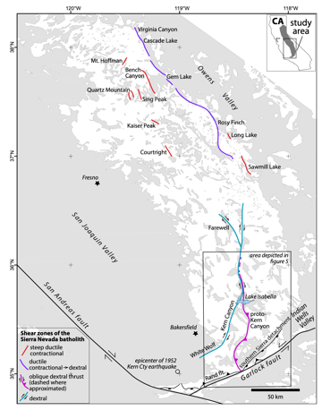
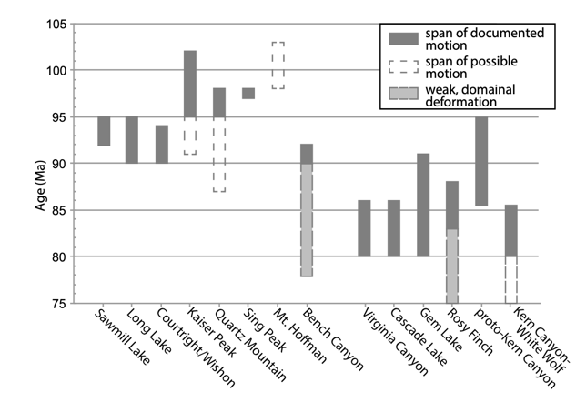
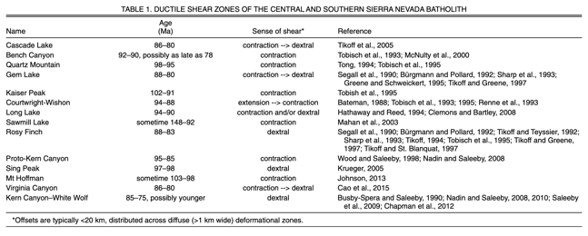
Shear Zones
Shear Zones younger than 90 MA record dextral transpression

Slide 5
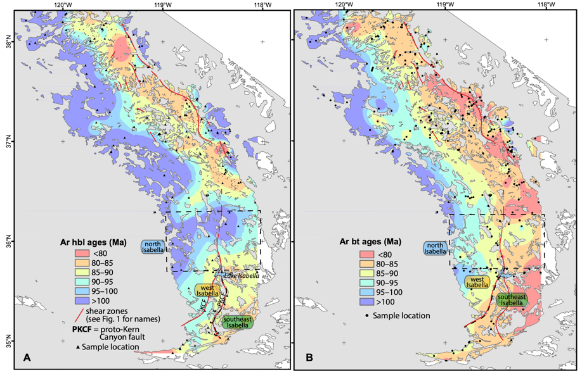
Hornblende & Biotite Ages
Most ages decrease eastward
Most of the eastern Sierra is younger than 80 MA (Biotite)

Slide 6
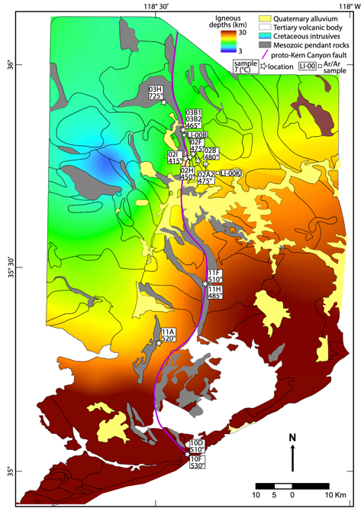
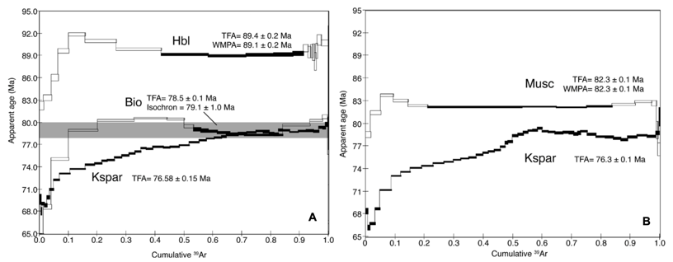
Cooling
Sample A cooled linearly, from 89-71 MA at a rate of 15ºC/MY, then cooled slowly until 69 MA (LI-00B)
Sample B cooled in similar fashion from 82-70 MA (LI-00K)
Both samples were from north of Lake Isabella

Slide 7
Regional SNB Thermal History
Plutonism was uninterrupted from 140-85 MA- thus cooing was variable
Timing of cooling was controlled by age of pluton
Eastern side of SNB cooled slowly and was constantly resupplied with magma, as opposed to west
Thermal barrier segregated southern shear zones from northern ones
Plutons in Kern Canyon Fault area were deformed during cooling (mylonites), suggesting an interval of shearing from 90-80 MA
Notes:
Regions that cooled earlier were older plutons, vice versa

Slide 8
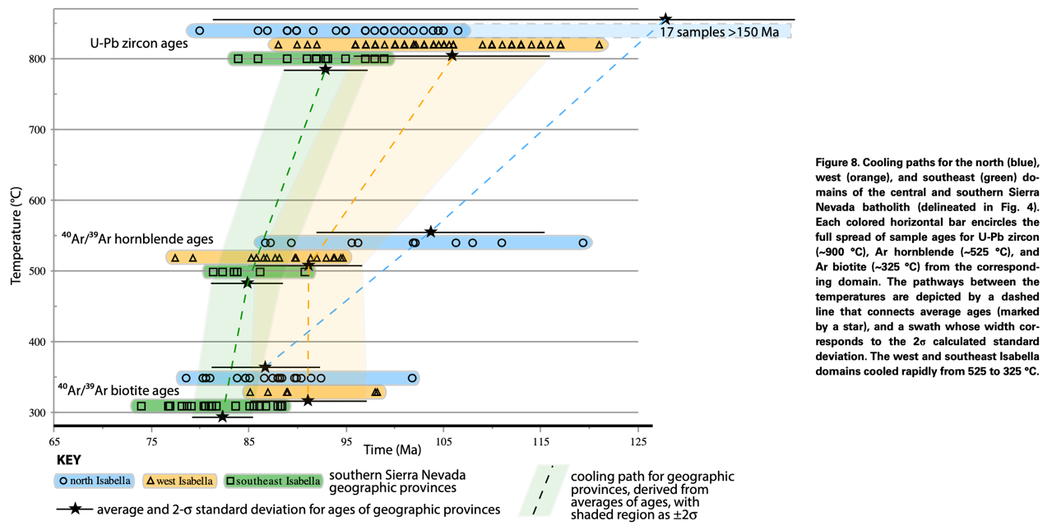
Cooling Paths for Central & Southern SNB

Slide 9
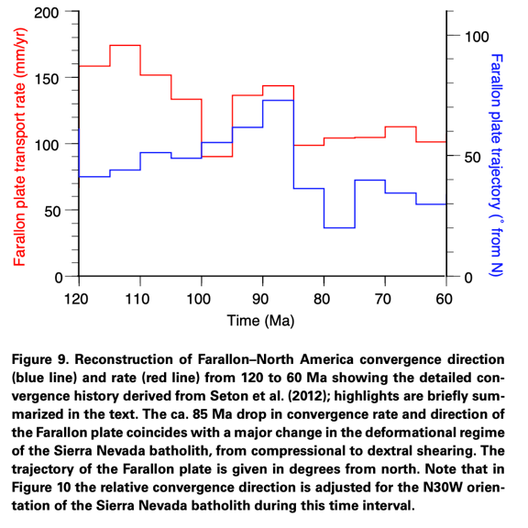
Regional Tectonics in Southern SNB
Subduction transitioned from normal to oblique convergence between 97-90 MA
Local features influenced timing and kinematics of deformation by subduction
The Shatsky Rise, a large oceanic plateau, began to be subducted under California 95-100 MA
It is postulated that this slowed subduction (due to increased traction from slab flattening and destruction of SNB Mantle wedge), and that the basaltic crust of SR reaching eclogite facies led to acceleration of convergence

Slide 10
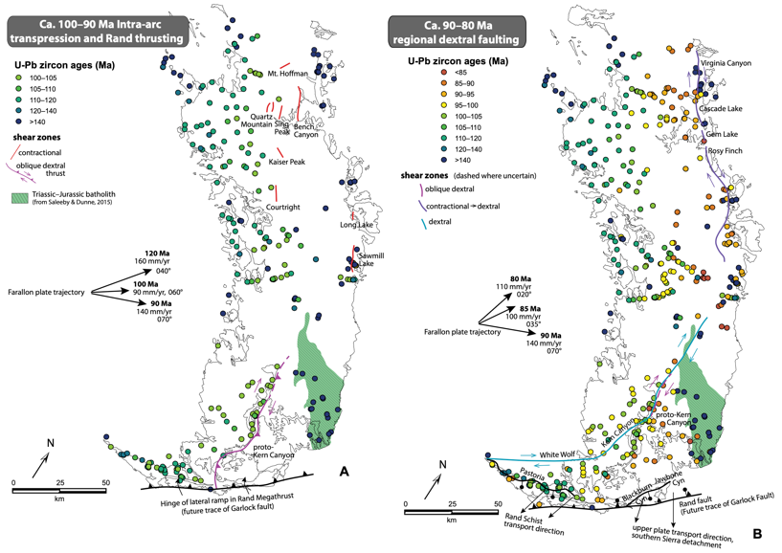
Regional Tectonics in Southern SNB cont.
The subduction of Shatsky Rise was highly influential to the southern SNB and Mojave Block. It:
Sheared off the entire mantle wedge, replacing it with subduction accretion assemblages (further north wedge was intact)
Developed the Rand Megathrust Fault, a north-dipping lateral ramp from Rand Schist to Franciscan Complex
Developed the proto Kern Canyon Fault as a crust penetrating lateral ramp that extended northward from the Rand Thrust and deformed the batholith

Slide 11
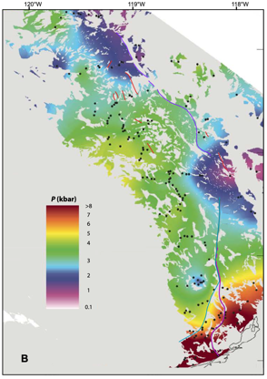
Conclusions
The Sierra Nevada Batholith experienced continuous plutonism from 140-85 MA
U-Pb Zircon, Ar Hornblende, and Ar Biotite ages show continuous cooling in most Sierra Nevada Magma, with west side cooling rapidly and east side cooling slowly due to to constant replenishing of magma
The southern SNB shows extensive deformation during cooling, especially near the Kern Canyon Fault
This is due to change in rate and angle of subduction of the Farallon Plate, which was nucleated by a local oceanic plateau coming in and messing everything up

